Slide 1
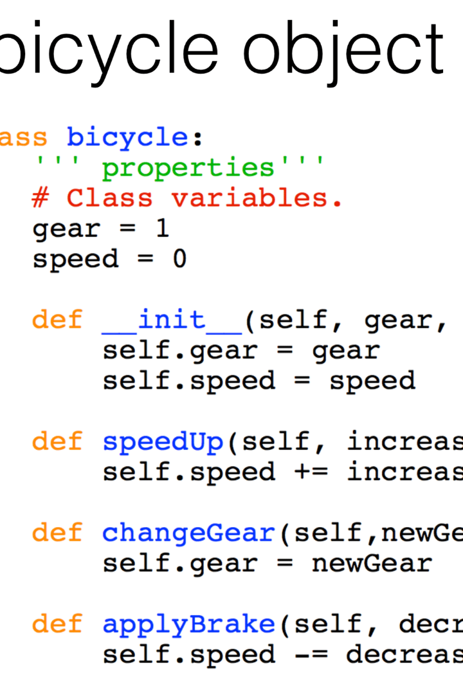


Use of Overloading in Object Oriented Concept
Object-oriented programming (OOP) is a programming concept that organizes code as objects having attributes and methods. Overloading is one of the key concepts in OOP that provides a way to define multiple methods or constructors with the same name but different parameters. It's an important and powerful feature in OOP.
by sawan kumar

Slide 2
Method Overloading
1
Definition
Method overloading allows defining methods with the same name within the same class but with a different number of arguments or data types.
Example
2
A class has two methods with the same name addNumbers, but one takes two integers as args, and one takes three integers as args. These methods enable the same operation to be performed with different inputs.
3
Benefits
Allows more flexible code, simplifies code readability, and promotes code reusability.

Slide 3
Constructor Overloading
Definition
Example
Benefits
Constructor overloading allows defining constructors with the same name but with different parameters that differentiate them.
A class has two constructors with the same name, Constructor, but with different args - one takes an integer, and the other takes a string. These constructors help create objects with different initial states based on the input.
Provides flexibility in creating objects, increases code readability, and reduces the number of classes used to represent related objects.

Slide 4
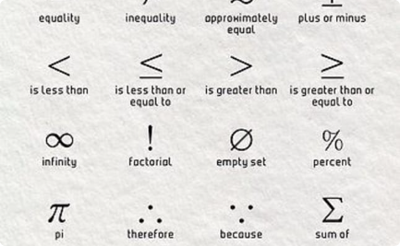
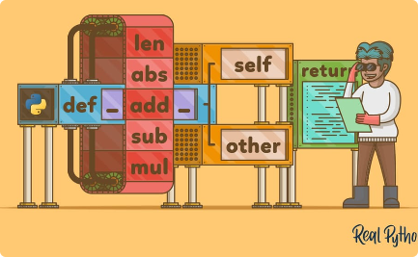
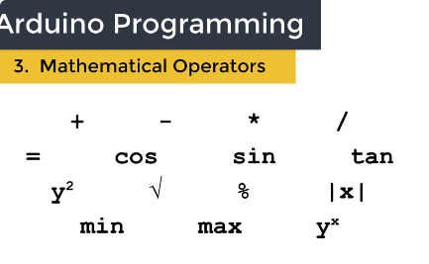
Operator Overloading
Definition
Example
Benefits
It allows operators such as +, -, /, or * to be redefined to work with user-defined data types.
A class has an overloaded '+' operator that adds two objects of the same class type. This addition functionality could be specific to the two objects.
Enables native operators to work with new, user-defined data types and reduces code complexity.

Slide 5
Comparison between Overloading and Overriding
Overloading
Overriding
Definition
Multiple methods can have the same name with different parameters in the same class.
Method redefinition in a subclass of superclass.
Return Type
Can have the same name with different return types.
Must have the same signature and the same return type.
Arguments
Must have different parameter lists.
Must have the same number and type of parameters.
Applicability
For methods of the same class and for constructors.
For inherited methods and for methods implementing an interface.

Slide 6

Conclusion
1
Importance
2
Use Case
Overloading is an essential feature of OOP and enables clean, reusable, and readable code.
Overloading is used in creating the Java Standard Library and the implementation of data structure.
3
Best Practices
Ensure methods have the same functionalities, document the overloaded method, and overload constructors with care.

Slide 7
Beyond the Basics
Polymorphism
Abstraction
Inheritance
Polymorphism describes the ability of a variable to represent objects of different data types. This concept complements overloading and overloading.
Abstraction is another concept in OOP that refers to hiding implementation details or complexity while providing a simple interface.
Inheritance allows us to define a new class based on an existing class, inheriting its properties and methods while also adding new ones.

